Slide 1
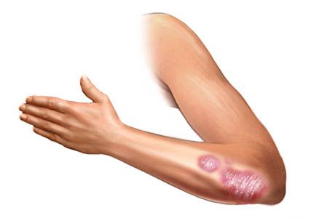
TPOT’s performance for Biomedical Data
Tim Beishuizen
Supervisor: Joaquin Vanschoren

Slide 2

Introduction
Computational Biology
  Data analysis framework
Last presentation
Biomedical Data
  Bariatric data set
Automated Machine learning
  TPOT
TPOT’s performance for Biomedical Data

Slide 3
Introduction
Contents
Change in data set
Research question
Methods
  Preprocessing
  TPOT usage
  Analysis
Results
  Preprocessing
  TPOT usage
  Analysis
Conclusion
Discussion
TPOT’s performance for Biomedical Data

Slide 4
Change in data set
Bariatric Data set – Skin disease data sets

Slide 5

Change in
data set
Originally a bariatric data set
Challenges
  Combining two data sets
  Missing values
  High error rate (5%)
No permission
TPOT’s performance for Biomedical Data

Slide 6

Change in data set
Skin diseases (NCBI)
  Psoriasis
  Atopic Dermatitis (Eczema)
Nine data sets
  54676 genes (features)
  Between 28 and 180 samples
Samples
  Normal skin
  Non lesional skin (not affected skin from patients)
  Lesional skin (affected skin from patients)
Challenges
  Data set heterogeneity
  High dimensionality
  Small sample set
TPOT’s performance for Biomedical Data

Slide 7
Research question

Slide 8

Research
Question
How does TPOT perform on specific biomedical data set problems and how can it be improved?
Hypotheses
Dataset heterogeneity
  No possibility of combining them
  Several preprocessing algorithms
High dimensionality
  Several preprocessing algorithms
Small sample set
TPOT’s performance for Biomedical Data

Slide 9
Methods
Preprocessing – TPOT – Combining data sets

Slide 10
Methods
Preprocessing
Downloading data
  NCBI database
Data omission
Data preparation
  Skin type mapping
TPOT’s performance for Biomedical Data

Slide 11
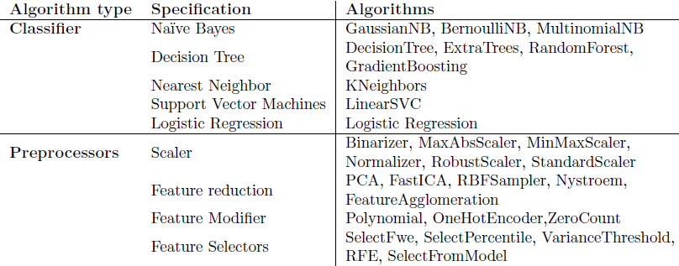
Methods
TPOT
Parameters
  Generations: 100
  Population size: 10
  Time limit: 120 minutes
Algorithms
Analysis
  Pipeline scores
  Cross testing
TPOT’s performance for Biomedical Data

Slide 12
Methods
Combining data sets
Data sets section
  Normal skin: 85 samples
  Non-lesional skin: 209 samples
  Lesional skin: 214 samples
Parameters
  Generations: 100
  Population size: 40
  Time limit: 480 minutes
Analysis
  Score
  Comparing single pipelines
TPOT’s performance for Biomedical Data

Slide 13
Results
TPOT – Combining data sets

Slide 14
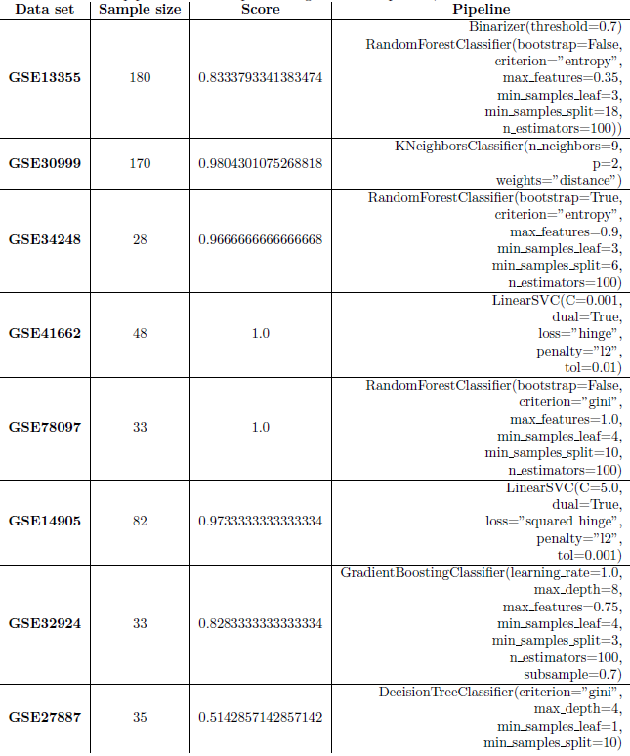
Results
TPOT (1)
Initialization problems
  Memory issues
  Feature Agglomeration
  Error in data set
Final pipelines
TPOT’s performance for Biomedical Data

Slide 15
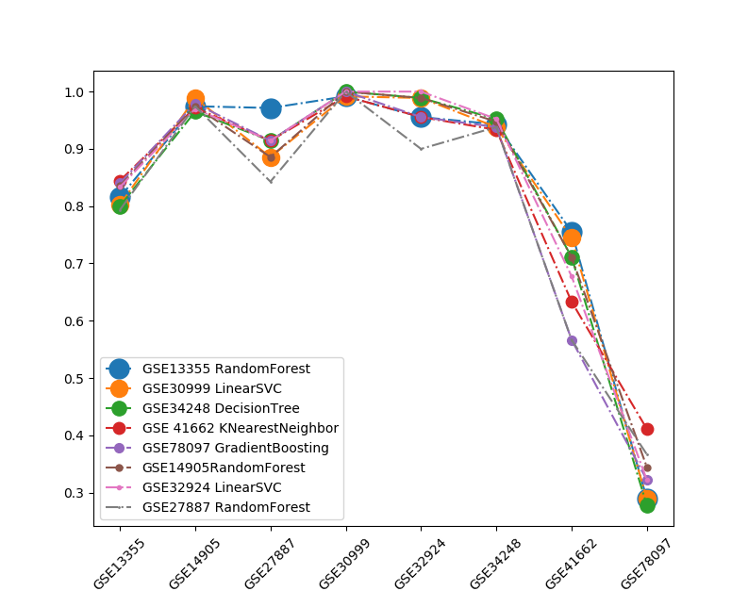
Results
TPOT (2)
Cross analysis data sets
TPOT’s performance for Biomedical Data

Slide 16
Results
Combining data sets
Best pipeline:
LogisticRegression(C=0.0001, dual=True, penalty='l2'), GradientBoostingClassifier(learning rate=0.1, max depth=5,
max features=0.05, min samples leaf=12,
min samples split=19, n estimators=100, subsample=0.5)
Score: 0.913725490196
Comparison other pipelines
  Overall best
  GradientBoostingClassifier closest (0.911)
TPOT’s performance for Biomedical Data

Slide 17
Conclusion
How does TPOT perform on specific biomedical data set problems and how can it be improved?

Slide 18
Conclusion
Dimensionality
  Memory issues
Heterogeneity
  Minor effect
Low number of samples
  Issues finding score
  Addition of sample generation possibilities
Good final pipeline
  Regardless of issues
TPOT’s performance for Biomedical Data

Slide 19
Discussion
How does TPOT perform on specific biomedical data set problems and how can it be improved?

Slide 20
Discussion
Exemplary project
Issue changing data set
  Lost execution time
Selection biomedical issues
  Complex data
  Missing data
Missing feature analysis
  Useful for further research
  Possible pipeline extension
TPOT’s performance for Biomedical Data

